Slide 2
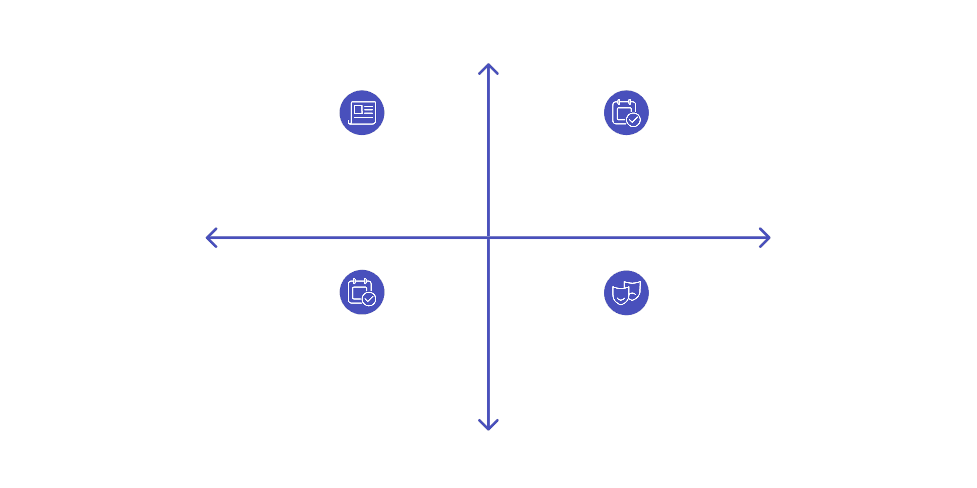



Vector Embeddings & Semantic Space
What Are Vector Embeddings?
Vector embeddings convert real-world content (documents, images) into numerical arrays with N dimensions. They live in semantic multi-dimensional space where position encodes real meaning.
Placing Documents in Space (2D Example)
High Realism
Short, real texts (papers, news)
Long, real books (textbooks, reports)
Short Length
Long Length
Long, fictional books (novels)
Short, fictional content (flash fiction, jokes)
Low Realism
Similar documents cluster together. Meaning emerges from position.
From 2D to High-Dimensional Space
Two dimensions aren't enough. Add popularity, creation time, author country → move to D-dimensional space (e.g., LLaMa 3.0 uses D = 4096)
Document
[36.7, 29.3, 17.2, 62.0, ...]
D dimensions
Key Takeaways
Vector embeddings = position in multi-dimensional space
Each axis represents a property (realism, length, time, popularity)
Similar vectors = semantically similar content
Clusters = emergent structure from data, not hard-coded

Slide 3
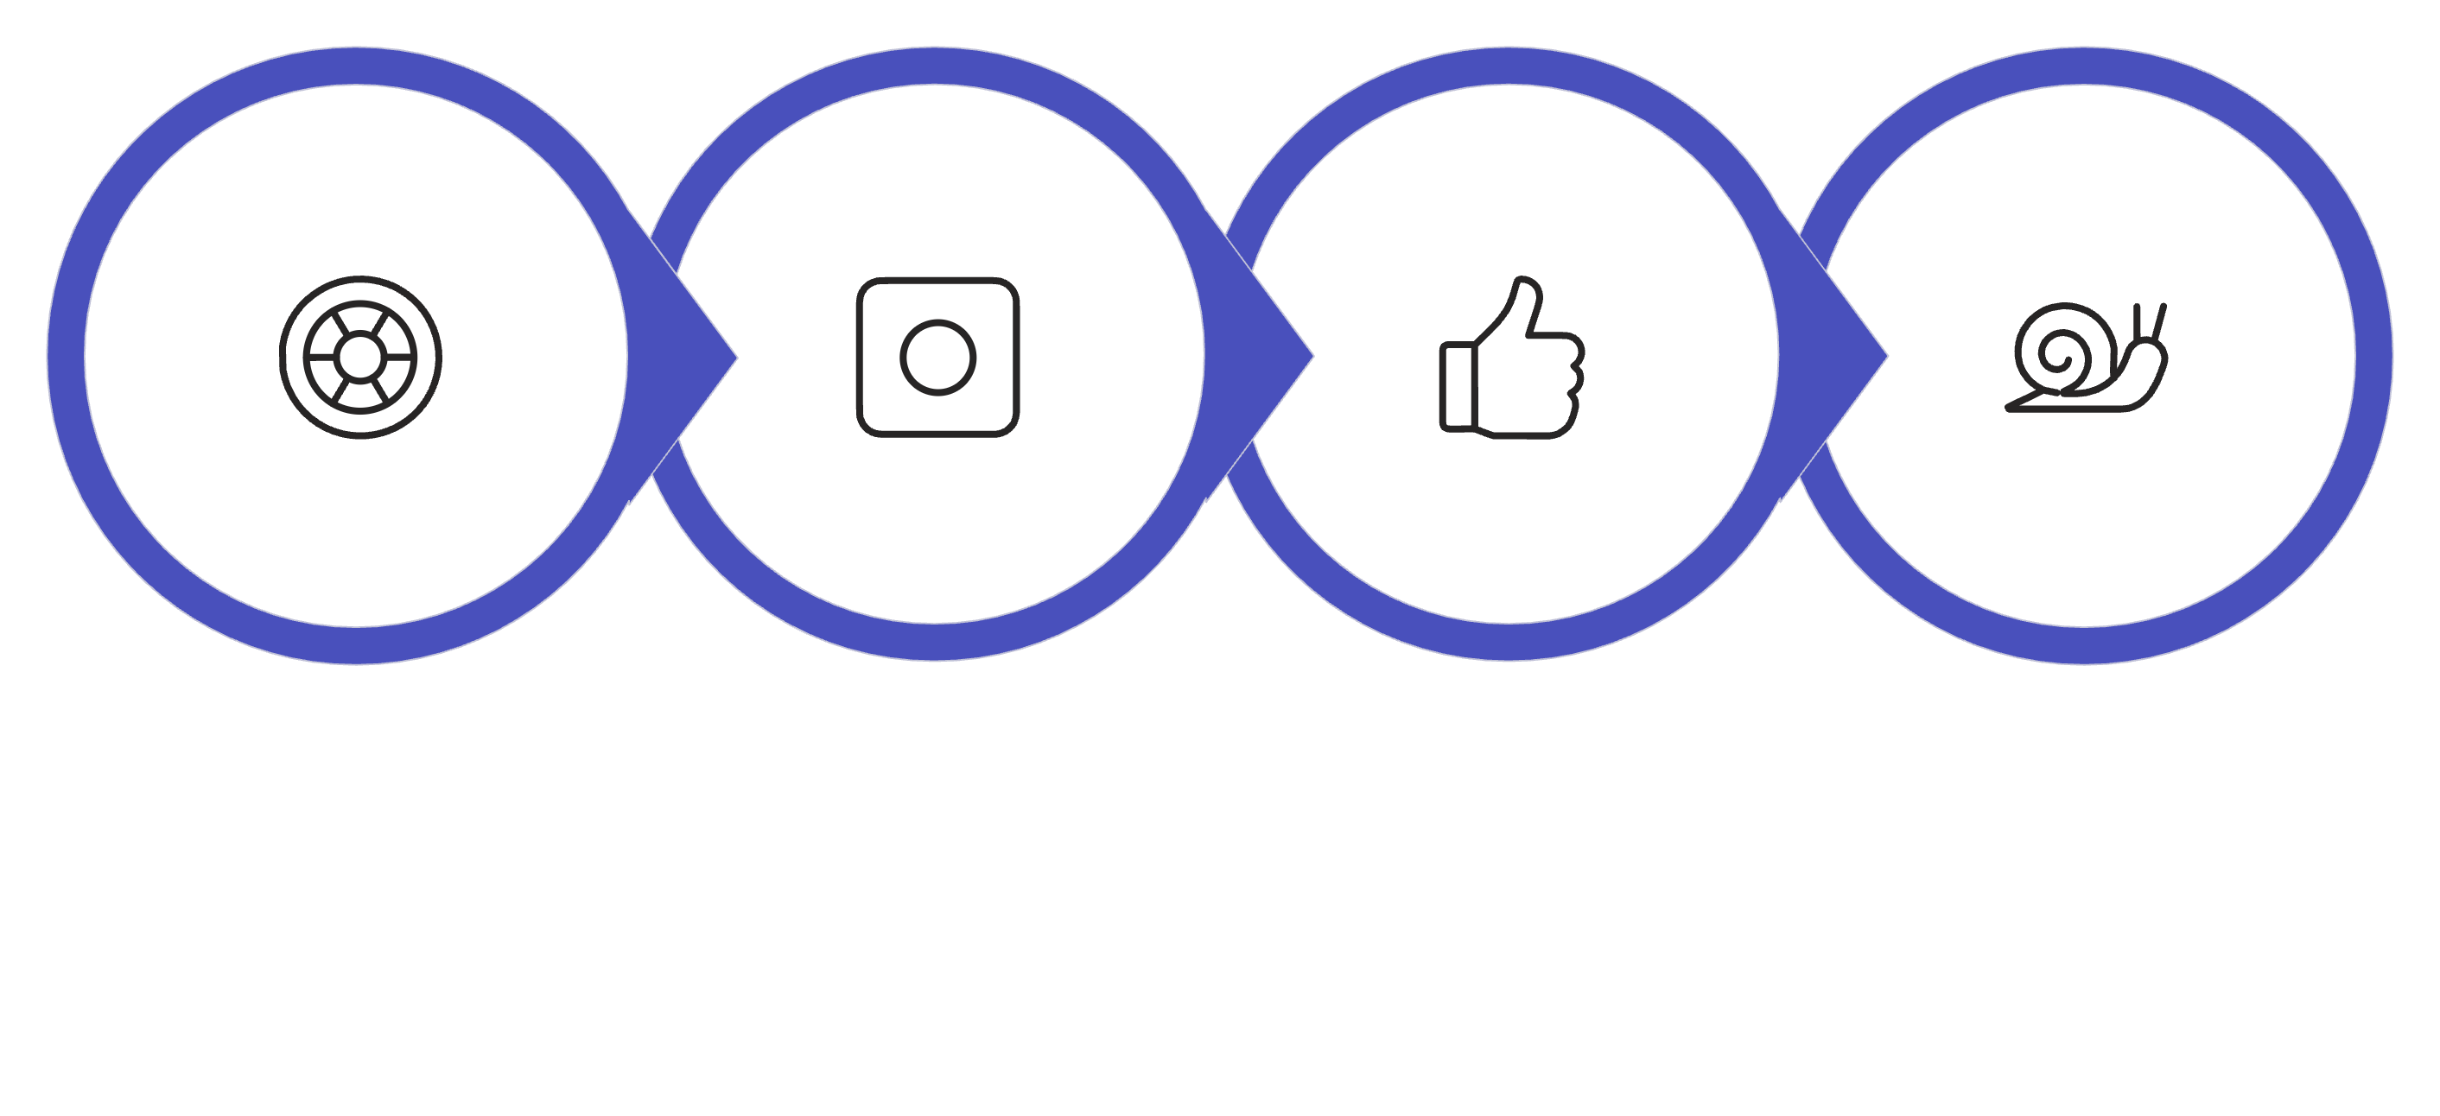





Why Brute Force Search Fails
10 Million Customers × 300 Dimensions
... = Too Slow
Visualize a tired computer scanning millions of dots one by one:
Scan
Check
Repeat
Slow
Checking everyone = O(N) time
Not scalable for real-time systems

Slide 4


The Breakthrough: Approximate Nearest Neighbor (ANN)
Inefficient Search
Efficient Search with Shortcuts
Imagine trying to find a restaurant in a new city by walking down every single street until you stumble upon one. This exhaustive search is incredibly time-consuming and inefficient, much like traditional exact nearest neighbor searches in large datasets.
Now, imagine pulling out your smartphone and using a GPS app. It instantly gives you the fastest route, bypassing unnecessary detours. This is the power of Approximate Nearest Neighbor (ANN) algorithms, providing fast, "good enough" results without checking every possibility.
ANN = GPS for Vector Space

Slide 5
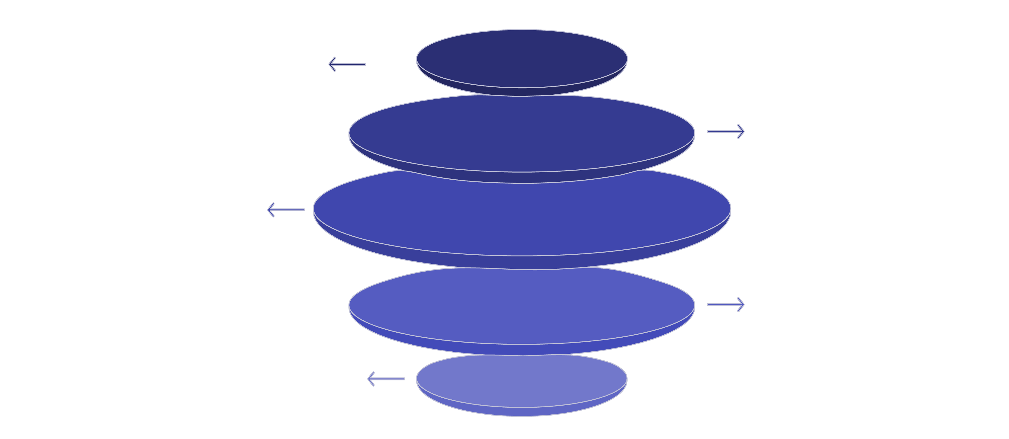
How HNSW Works (Graph Shortcut Model)
Top Layer
Few large, loosely connected nodes
Global Jump
Fast long-range transition path
Middle Layer
Denser, more interconnected nodes
Local Descent
Slow, detailed neighborhood search
Target Node
Pinpointed node in dense cluster
Fast global jump, slow local search.

Slide 6

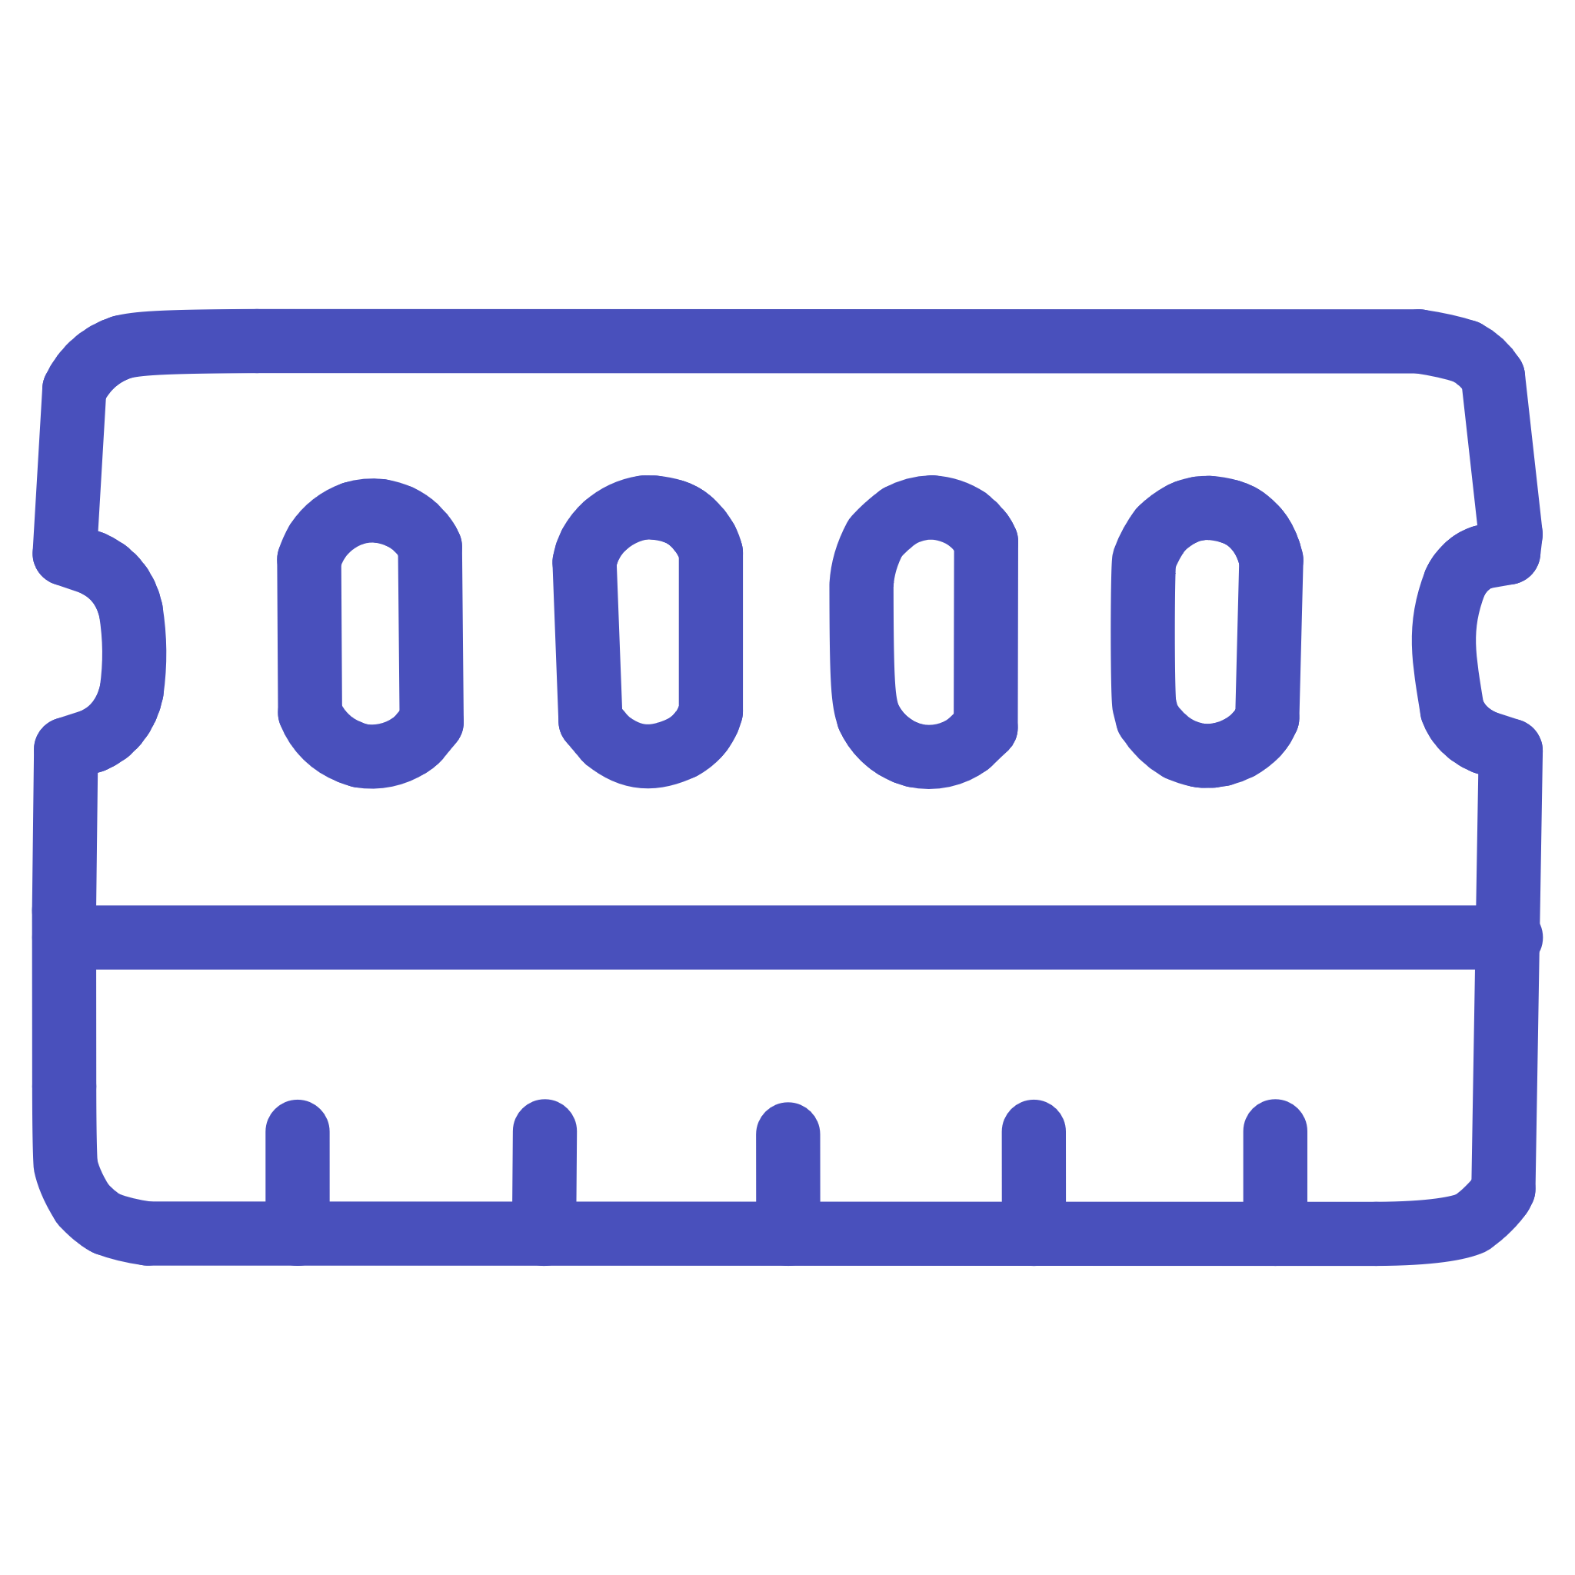


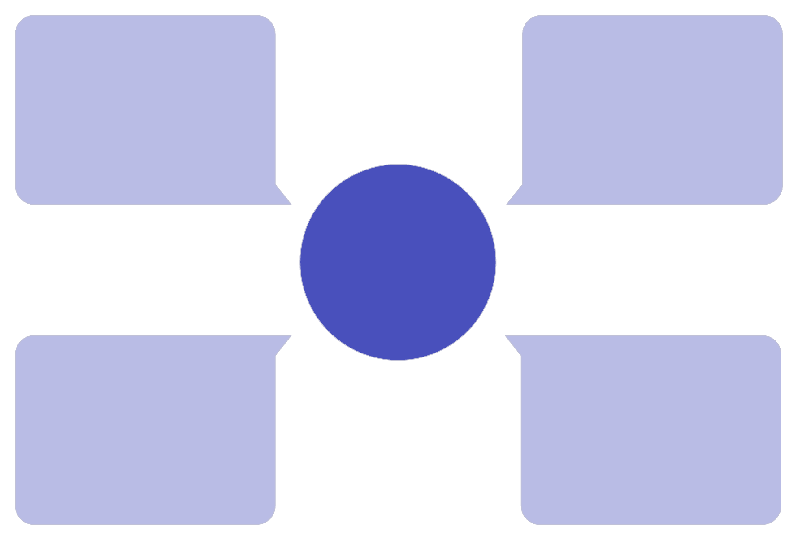
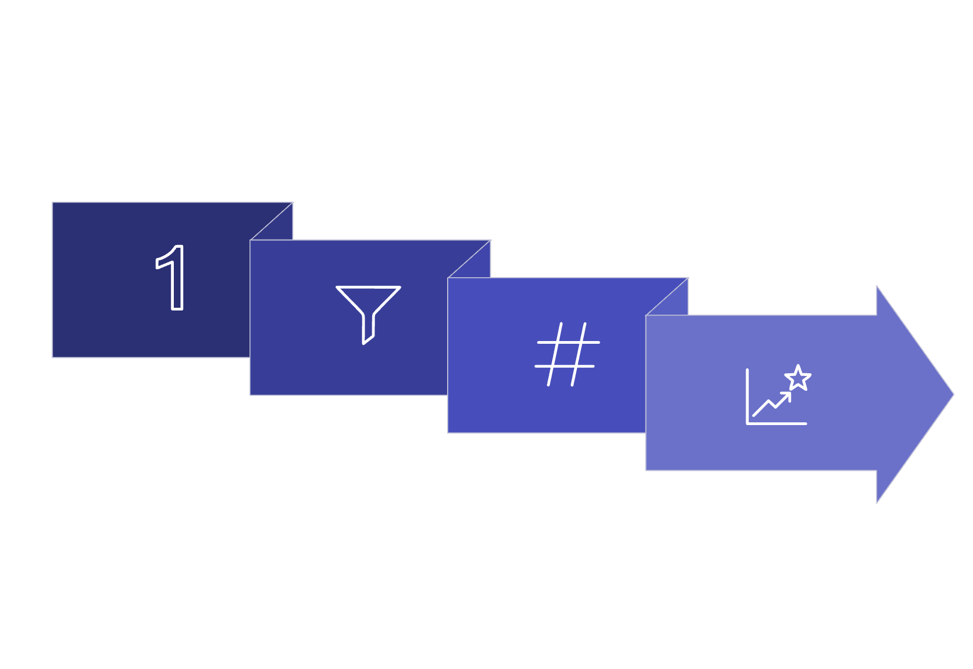




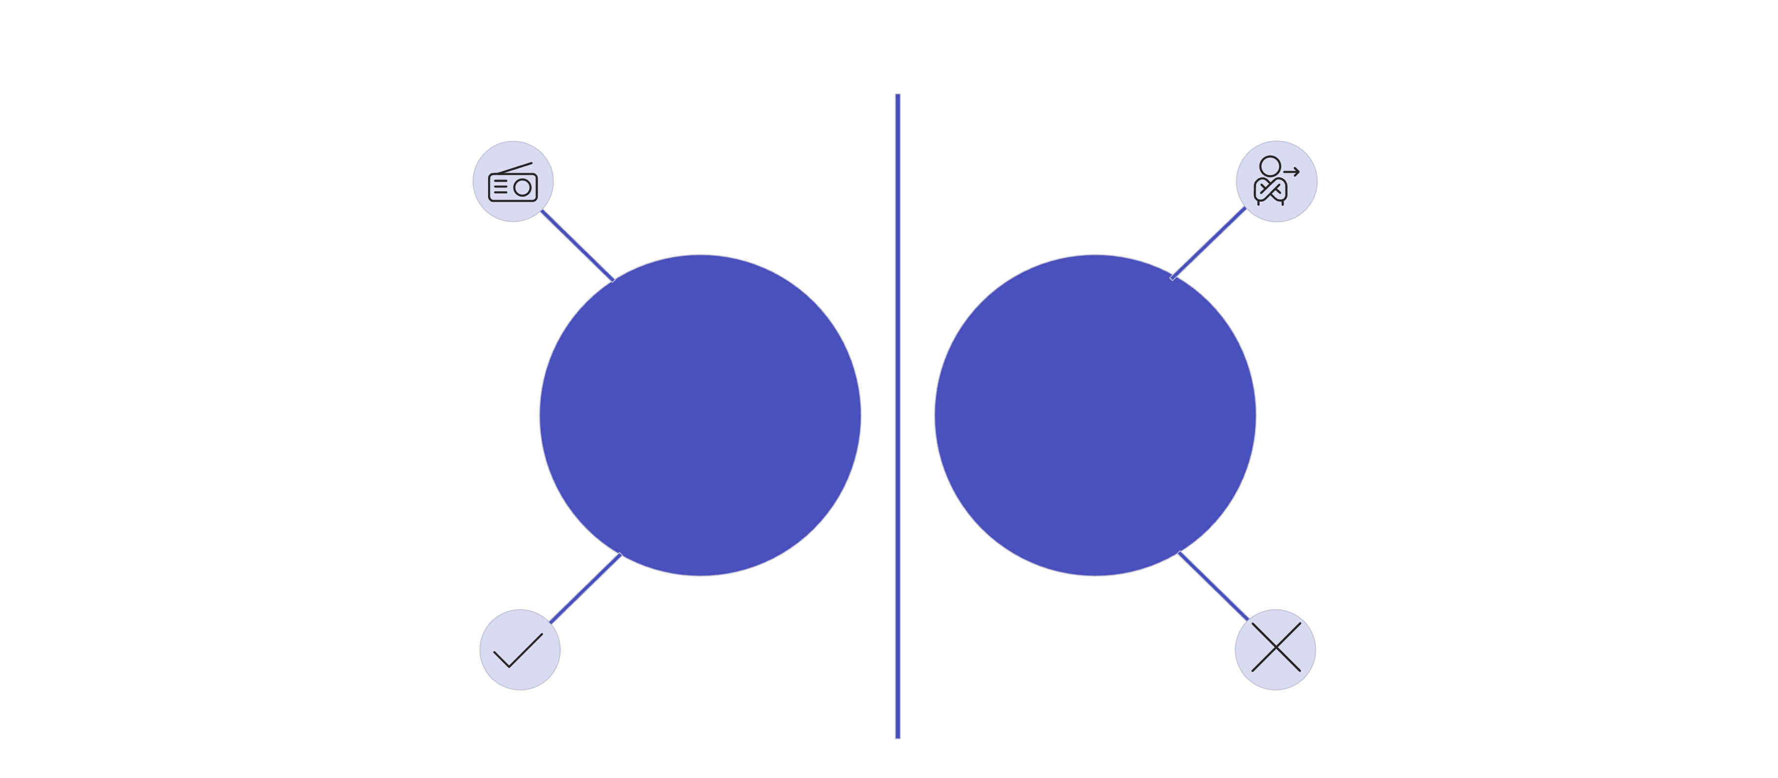




Compression & Quantization
Scaling Vectors Efficiently
The Problem
307.2 GB
100M interactions × 768 dimensions = Storage Crisis
Why Compress?
More vectors in RAM
Reduced search latency
GPU compute feasible
Two Compression Methods
Product Quantization (PQ)
Scalar Quantization (SQ)
512 bytes → 8 bytes
128-D vector bar
Original high-dim representation
Quantize
64x reduction
Product Quantization Compression
Faster but blurrier
Floats
Map to centroids
Split into 8 chunks
Ints
Each sub-vector → codebook entry
Eight 16-D sub-vectors
Used by: Facebook FAISS, Milvus
Simpler but less precise
Faster but blurrier
The Trade-off
Clear signal
Faint signal
Strong stations
Weak stations
Top matches ✓
Long tail ✕
Impact: Bad for recommendations, harms ranking
Key Takeaways
Vector compression = fast, scalable search
PQ: Most powerful (sub-vector + codebook)
SQ: Simpler per-float quantization
Always balance: size vs recall vs latency

Slide 7

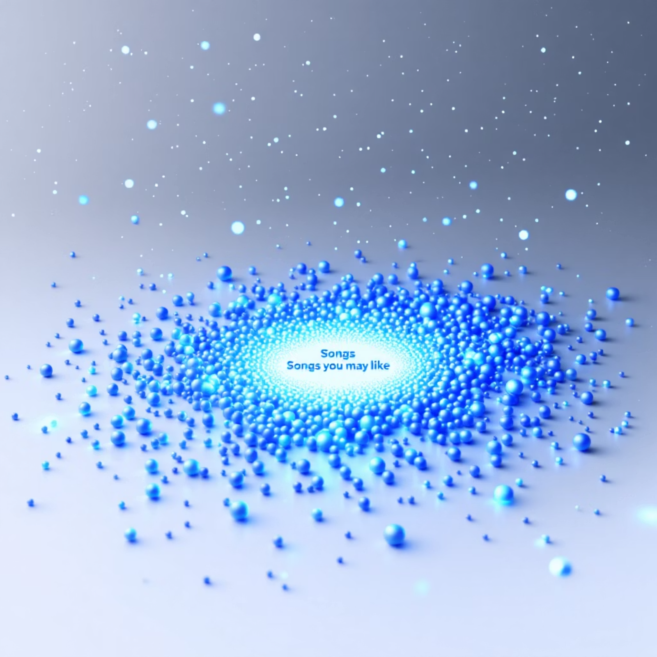
How Spotify Uses Vector Search
How Discover Weekly Is Born
Your Listening History
Cloud of Song Dots
Rock, Indie, Synth
Millions of songs in vector space
Converted to Vector
User's taste profile
ANN Search Pipeline
User Vector → Song Vectors → ANN Search → Playlist
Find songs closest to your taste vector

Slide 8

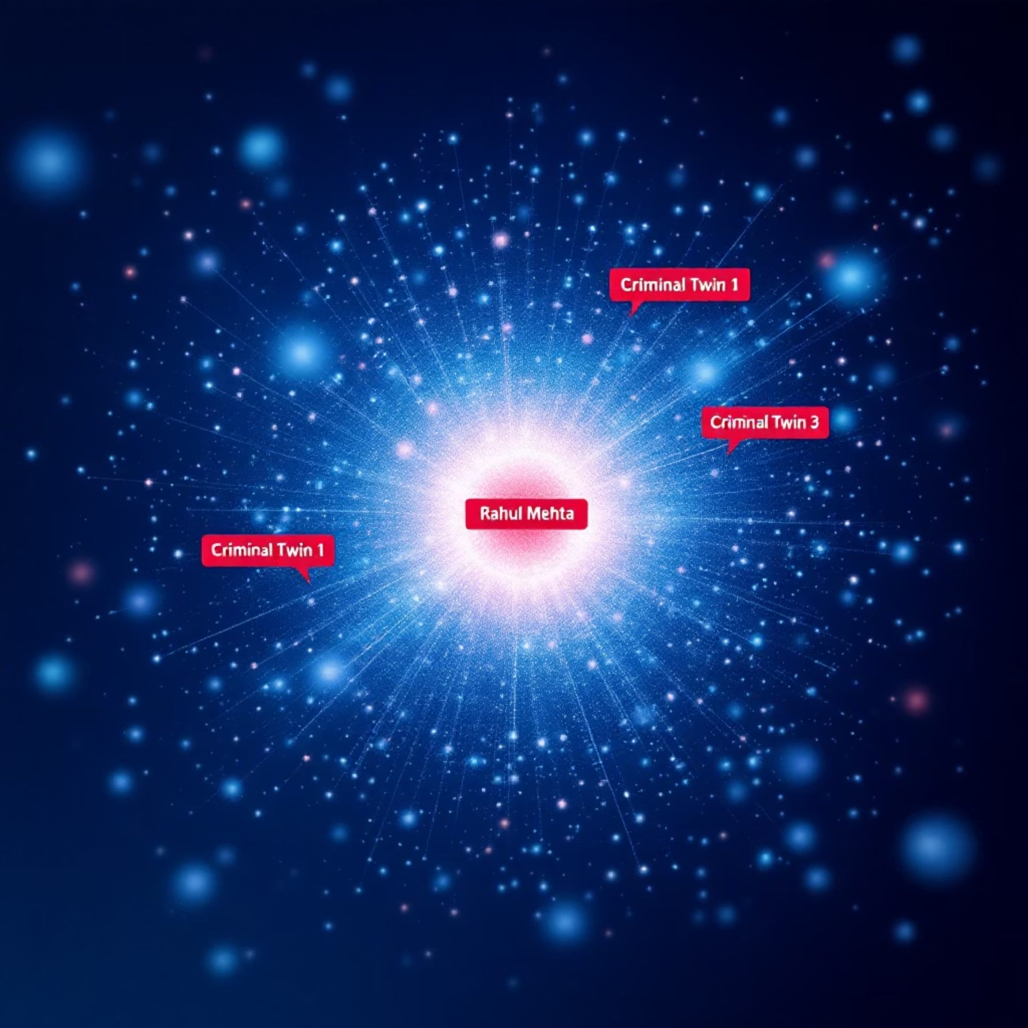
AML Parallel: Finding Criminal Twins
Spotify for Financial Crime Detection
Similar Songs
Similar Criminals
In Spotify's approach, individual users like Rahul Mehta are mapped to a vector space based on their listening habits. Songs that are "near" this vector are recommended.
Similarly, in AML, customers are mapped into a behavioral vector space. High-risk individuals like Rahul Mehta become reference points to identify "criminal twins" – others with highly similar, potentially illicit, behaviors.
92% Behavioral Match Detected
ANN finds hidden mule networks in seconds

Slide 9

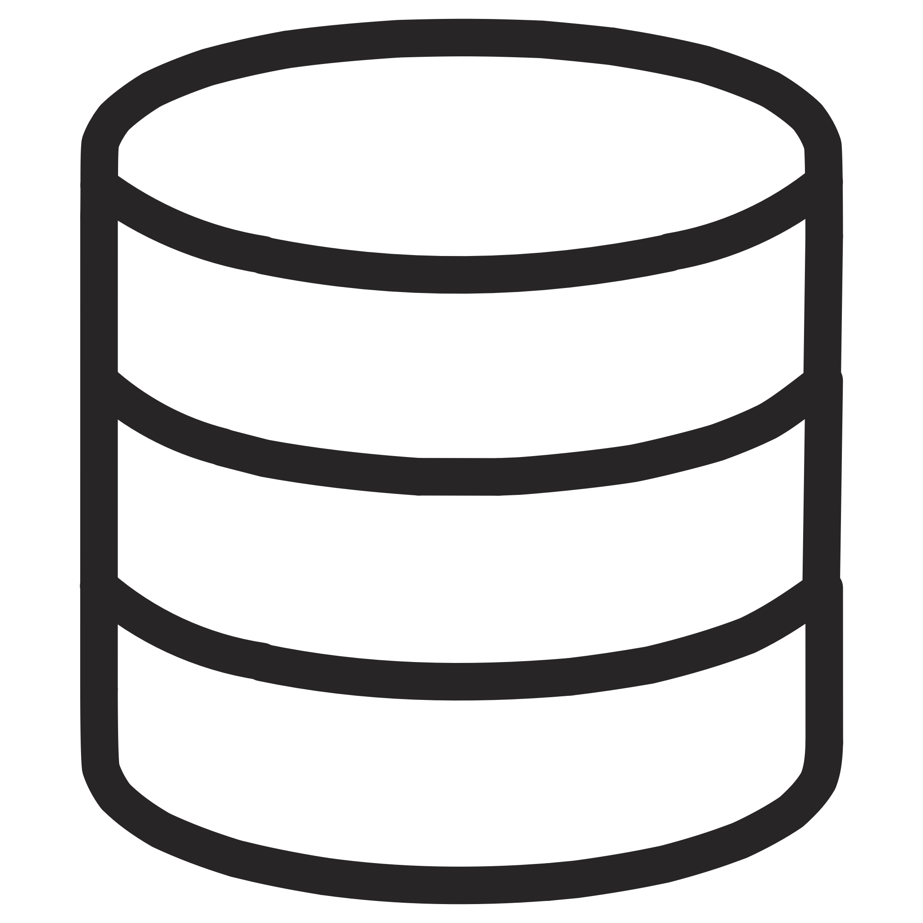

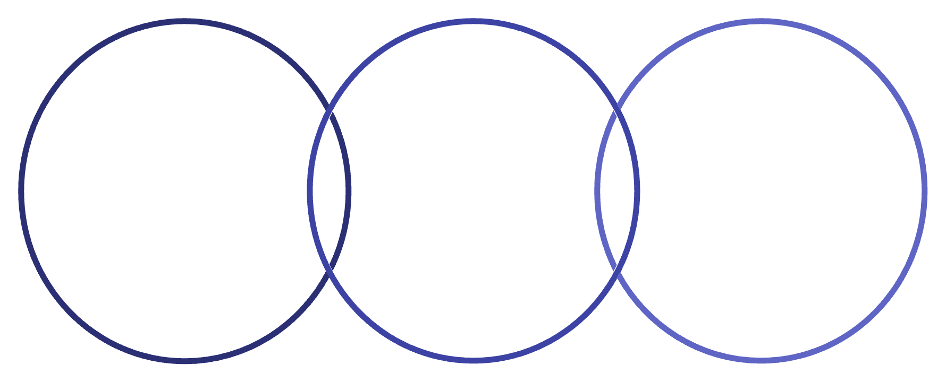
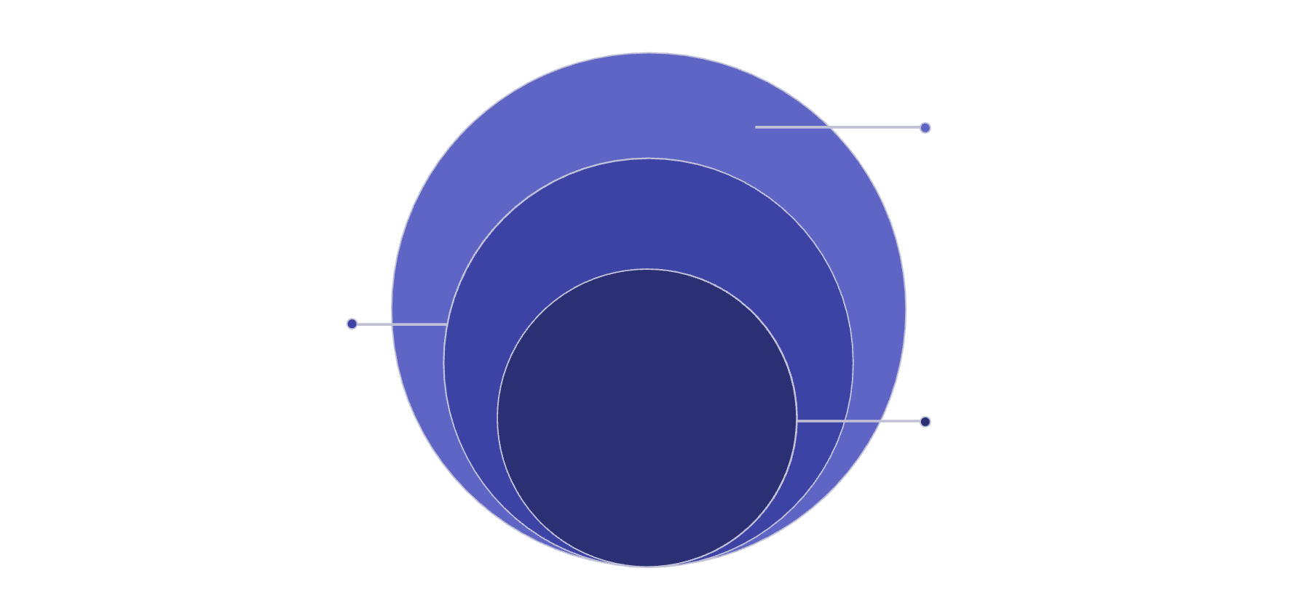
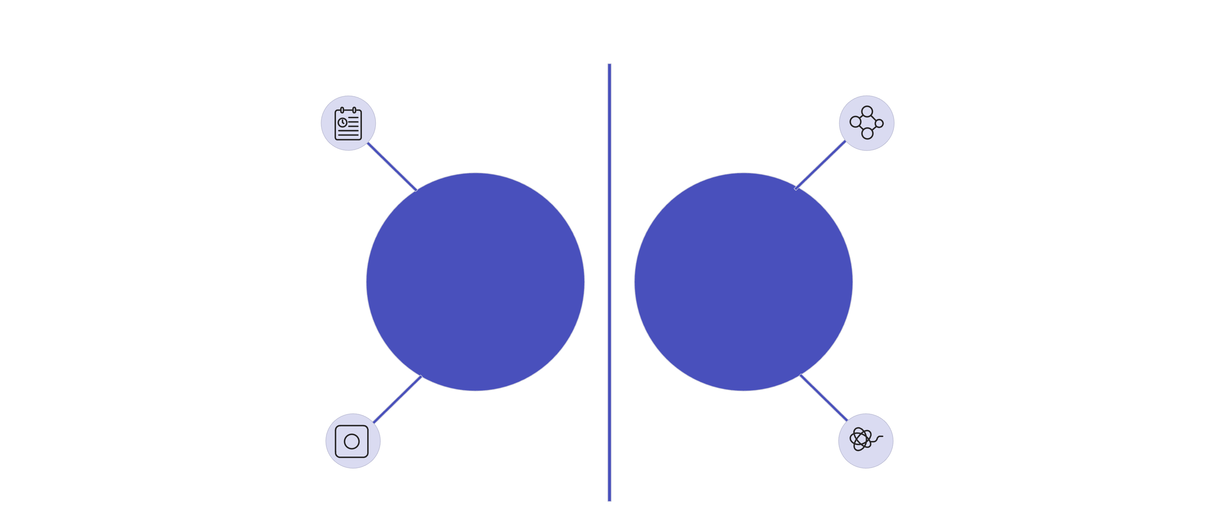




Indexing Techniques for Vector Search
Making Vector Search Scale
Database indexes help retrieve relevant vectors without scanning everything. They're data structures that enable fast search and retrieval.
Why Indexing Matters
TRADITIONAL DBS
NOSQL DBS
VECTOR DBS
B+ Trees
Sorted String Tables
Vector Indexes
Organized data for fast retrieval based on exact matches or ranges.
Efficiently store key-value pairs for quick lookups in distributed systems.
Specialized structures to find approximate nearest neighbors in high-dimensional spaces.
Two Main Techniques
IVF (Inverted File Index)
HNSW (Hierarchical Navigable Small World Graph)
Dense Bottom Layer
Many tightly interconnected target nodes
Cluster A
Cluster B
Query Point
K-Means group with centroid
Nearby cluster, distinct points
Searches nearest centroid
Intermediate Layer
Moderate connectivity guiding search
Sparse Top Layer
Few widely connected hub nodes
Key Concept: Cluster and Conquer
Cluster the vector space, then search only relevant clusters to find approximate nearest neighbors.
Key Concept: Multi-level Traversal
Tunable Parameters:
Builds a graph where connections are shorter in higher layers and denser in lower layers. Search starts high and "zooms down" like climbing a mountain.
Number of clusters (how many partitions)
Number of clusters to search at runtime
Performance:
More Clusters
Very high recall
Low latency
Better recall, but slower search time.
Efficiently finds approximate nearest neighbors
Few Clusters
Faster search time, but less accurate recall.
Comparison Table
Speed
Fast
Fast
Accuracy
Needs config (tunable)
High
Memory
Low
High
Hardware
GPU-friendly
CPU-friendly
Construction
Fast
Slow
Why Not QuadTrees/R-Trees?
Clear grid layout
Dense, overlapping points
High-Dimensional Space
2D Space
Points well separated
Indistinguishable distances
They work efficiently in 2D/3D but struggle and fail in 100D+ due to the curse of dimensionality.
Key Takeaways
Indexing makes vector search practical at scale.
IVF: Splits vector space into clusters for efficient search.
HNSW: Builds a graph with multi-level traversal for high recall and low latency.

Slide 10
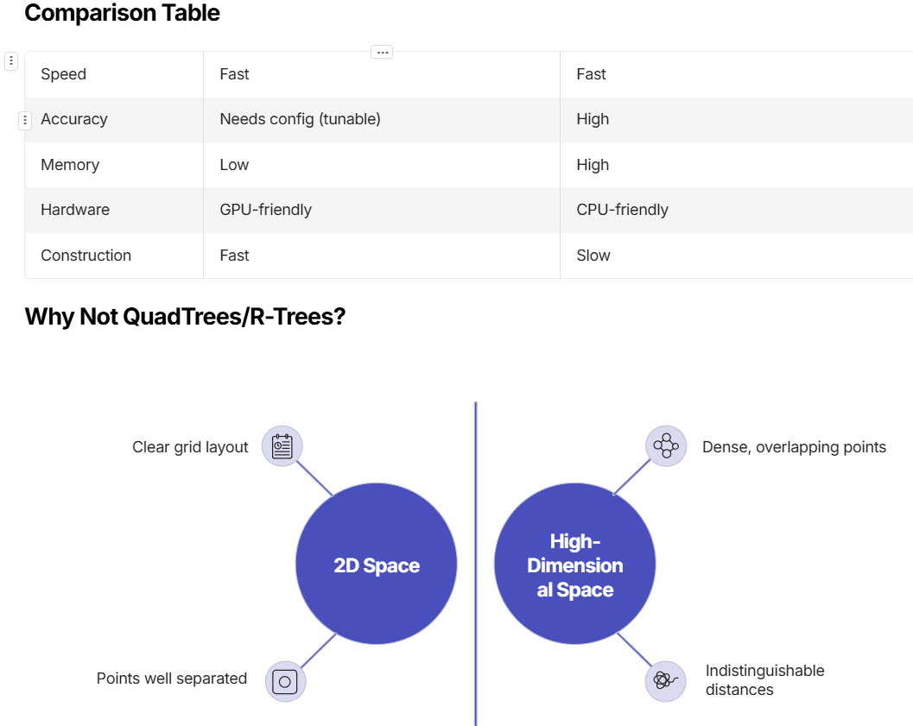
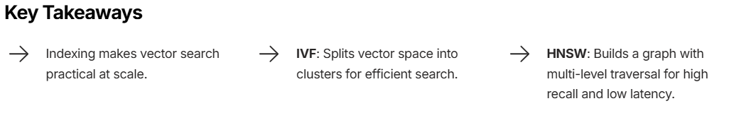

Slide 11
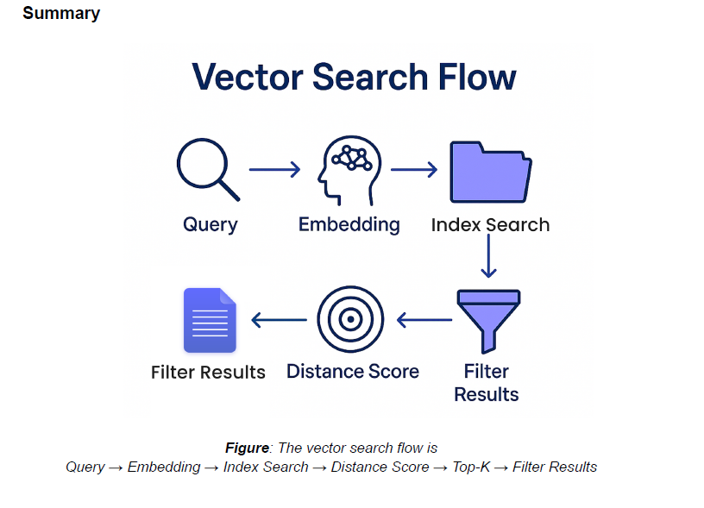

Slide 12





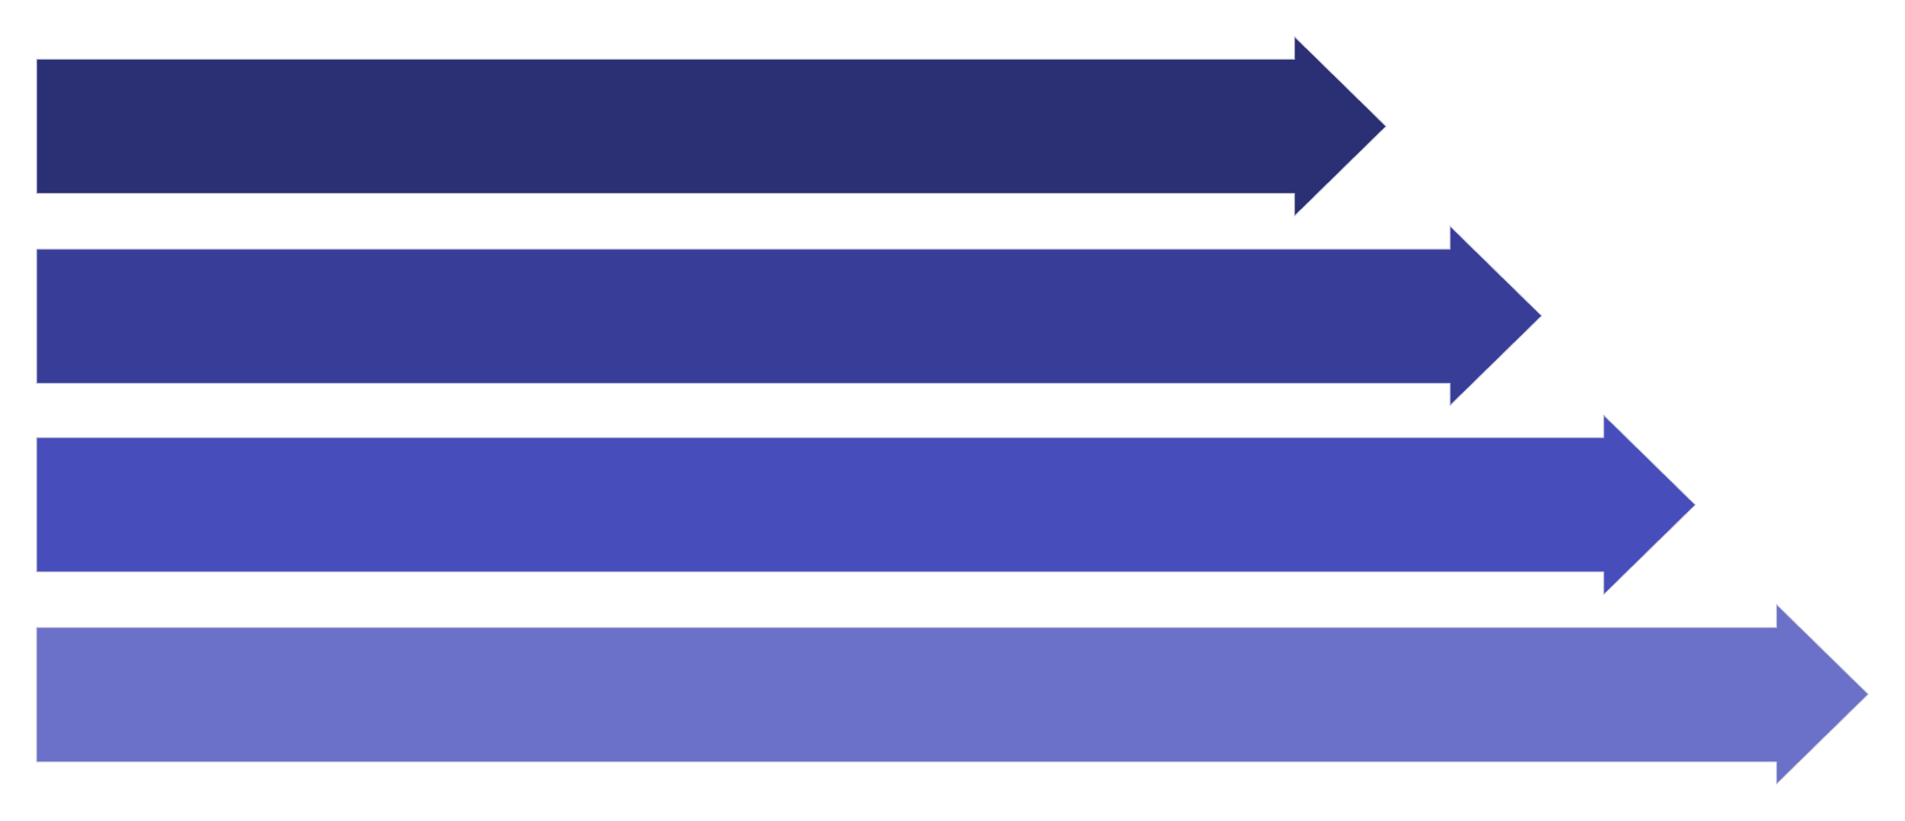
Search Execution Flow
From Query to Result
Follow the journey of a user query as it transforms into a meaningful search result in a vector database.
1. Embed the Query
User Query
Embedding Model
High-Dimensional Vector
Text or image input
Translates query into vector
(e.g., 384D, 768D)
Query encoded in the same semantic space as documents.
2. Search the Index
Query Vector Entry
ANN Index Search
Vector enters the index structure
Utilizes IVF or HNSW for efficient approximate nearest neighbor search
Uses ANN indexes (IVF, HNSW) – not binary search. Searches N dimensions at once.
3. Score & Rank
L2 Distance
Cosine Similarity
Dot Product
Measures Euclidean distance between vectors.
Measures angle between vectors (preferred for text).
Calculates the magnitude and direction relationship.
Compute similarity scores for candidate vectors, then return the top-K closest results.
4. Post-processing & Filtering
Language = English
Top-K Results
Filtered Results
Metadata filters are applied after vector scoring to refine results.
Complete Search Pipeline
Query
Embedding
Index Search
Distance Score

Slide 13
